Slide 1
Stouffville Creek Retirement Home
WE promote SAFETY AND SOCIALIZATION!!!!
Dorina Rico, RN, MScN, MBA General Manager

Slide 2
The Stouffville Creek “Vacation” Experience

Slide 3
Stouffville Creek Dining Experience

Slide 4
Dancing and Singing at Stouffville (Pre Pandemic)

Slide 5
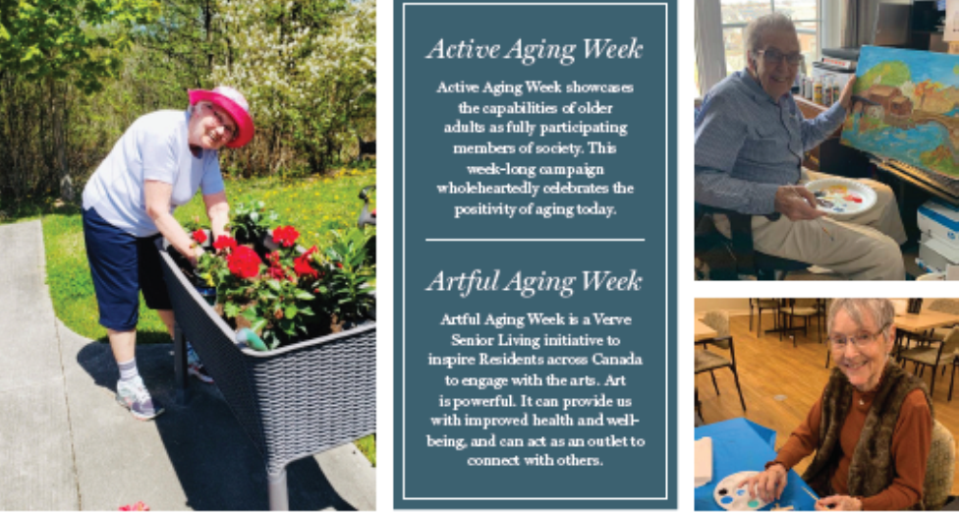
Current Activities – Keeping Safe

Slide 6
“Cruise Week” Special Events (safely)

Slide 7
Why are you being asked to get vaccinated first?
COVID-19 has affected many
Vaccines will help us end the pandemic and return to normal
Your colleagues and residents are relying on you
Keep healthy to be able to keep caring for our most vulnerable
Your community wants you to stay healthy
Keep yourself and your friends and family safe
Notes:
More than 15,000 Canadians and over 350,000 Americans have died of COVID in less than a year. COVID has killed 6 times more people than the flu. People working in healthcare settings and visible minorities are disproportionately affected.
Please just like you are getting ill. Even if a young and healthy person does not die of COVID-19 infection, they may have long term complications from COVID, affecting multiple organ systems. Long term effects include brain fog, body aches, and damage to the lungs and heart. Many cannot go back to work or live a normal life.
If you get sick, the patients or residents, and their families who count on you will be let down. A vaccine is the way to end this pandemic. All the members of the healthcare team around you will be getting immunized; you can also protect yourself, your loved ones, and your community by getting vaccinated.

Slide 8
Special circumstances
Everyone is encouraged to get vaccinated even if they have previously had COVID-19 as the vaccine will likely help you stay immune much longer
Most experts believe the benefits outweigh risks for people who are pregnant or who have conditions affecting their immune system.
Those with any serious allergies or health conditions should speak with their doctor before receiving the vaccine.
It is always an option to speak with your doctor about your special circumstances, or we can help you find advice.

Slide 9
What is the efficacy of the COVID-19 Vaccines?
 | Pfizer (BNT162b2) (over 40,000 doses) | Moderna (mRNA-1273) (over 30,000 doses)
Efficacy | 95% protection from having the disease | 94.1% protection from having the disease
Similar efficacy across race/ethnicity and age groups

Slide 10
The COVID-19 Vaccines are Safe
Both mRNA COVID-19 vaccines met Health Canada’s stringent safety requirements and were approved after a thorough, independent review of the medical evidence, which included clinical trials involving over 70,000 volunteers over 8 weeks.
No major safety concerns were identified. In general, the side effects observed during clinical trials were similar to common side effects of other vaccines (e.g., body chills, injection site pain) and do not pose a risk to health.
Side effects from mRNA vaccines may occur within 6 weeks of vaccination and are a sign of the immune response. Based on the clinical trials:
Most people will have a sore arm.
Many will have mild headache or body pain or tiredness for a day or two.
A small number will get fever – those people need a COVID-19 test to ensure they did not contract COVID-19 prior to receiving the vaccine.
The mRNA vaccines cannot give you COVID-19 or any other infection.
The mRNA vaccines cannot change your DNA.
To date, no serious adverse effects have been identified with the vaccines approved for use.

Slide 12
Thank you!
Questions?

